Slide 3
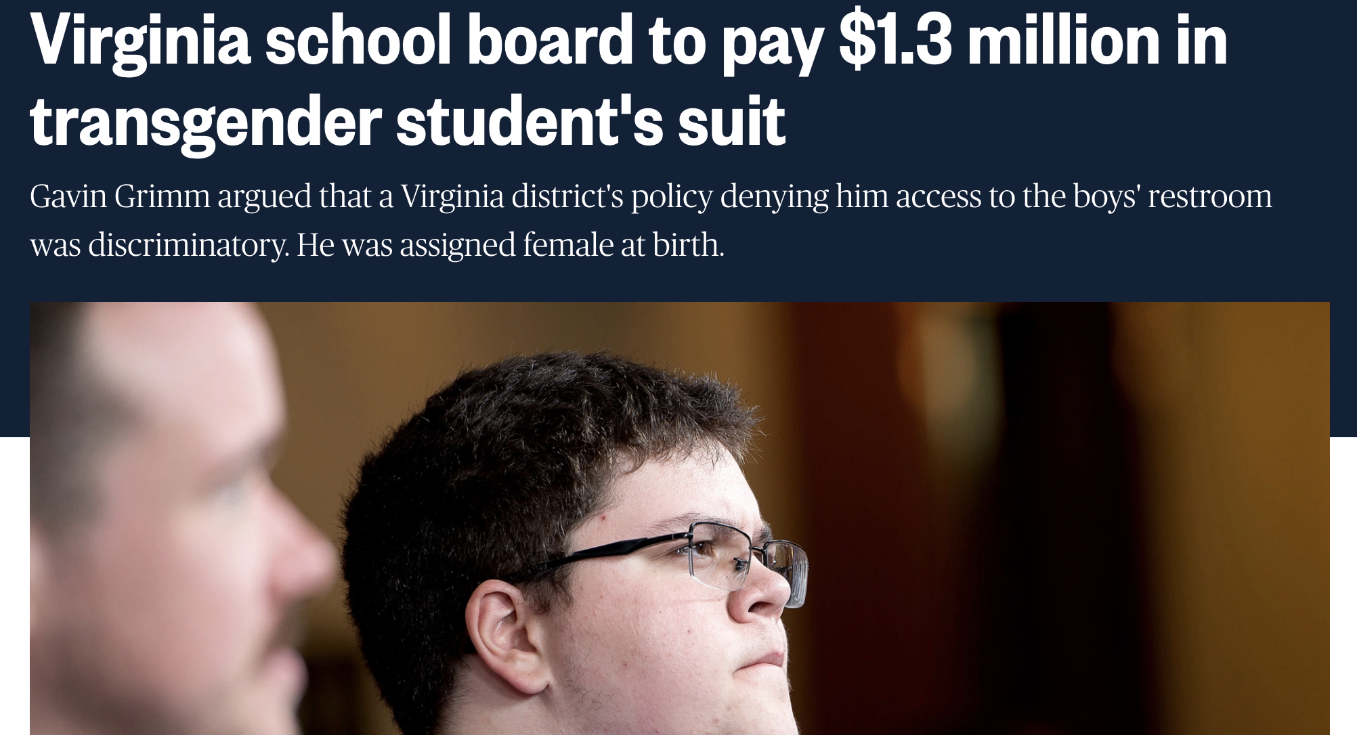

Slide 4
Let’s Talk
Best practice communication principles and strategies to navigate these challenging times
Apply to situations Virginia superintendents are experiencing and learn how to proactively communicate to keep the focus on the “why”—our students
Remind you of access to the Donovan Group’s services in a time of crisis through partnership with VASS

Slide 5
Our Landscape
Politically divided communities
Pandemic challenges
Community members challenging efforts to meet the needs of every student
Transgender students
Book/instructional material challenges
Heavily funded organizations focused on education

Slide 6
Best Practices for These Times
Keep the focus on our why
Seek greater community engagement
Be proactive and strategic

Slide 7
Best Practices for These Times
Reframe messages
Engage in the wins
Deal with the impact and move forward

Slide 8
Challenges in Meeting the Needs of Every Student
What is happening?
What are the goals of your communication?
Who are the stakeholders?
What are the key messages?
What are the best communication tools?

Slide 9
Virginia School Division Case Study
Division Facts
Action Taken
Key Takeaways

Slide 10
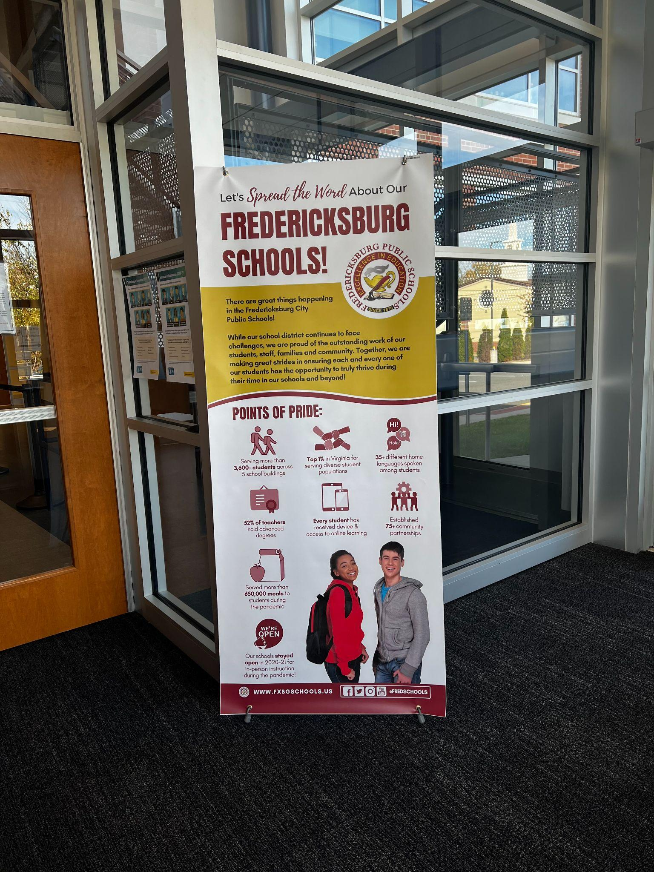

Slide 11
Book Challenges
What is happening?
What are the goals of your communication?
Who are the stakeholders?
What are the key messages?
What are the best communication tools?

Slide 12
What are you navigating?

