Slide 1
Student Voice, Community Partnerships, and a Wraparound Initiative Leigh Colburn

Slide 2
Disproportionality
Student
Supports
Culture
Graduation Rate
Immigration

Slide 3
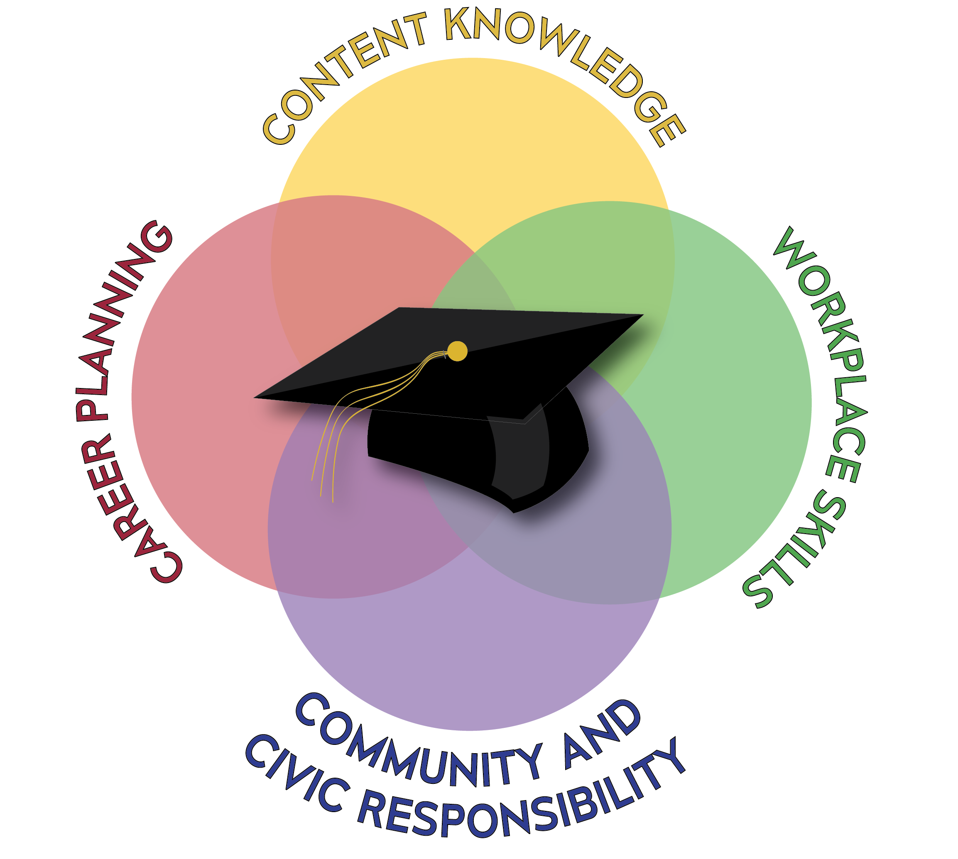

Slide 4
Columbia County Community Meeting 2018

Slide 5
Four Ways to be Brave and LEAD
Seek the Truth
Speak the Truth
Stretch Yourself (confront the BUT)
Serve Others
Notes:
(note to self – definition of leadership – Develop the Potential of Others, Meet the Needs of Others)

Slide 6
Wraparound Services
HEALTH &
WELLNESS
SAFETY & JUSTICE
BASIC NEEDS
COLLEGE & CAREER
TRANSITION
COMMUNITY SERVICES
ACADEMIC
OPPORTUNITY

Slide 7
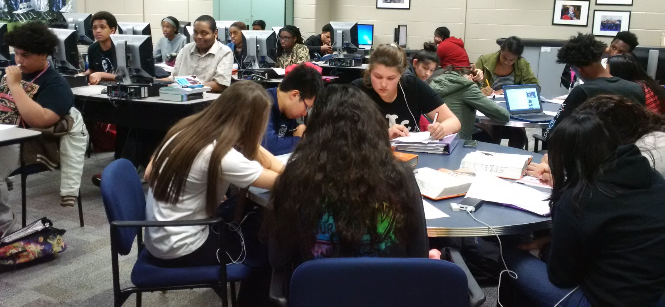
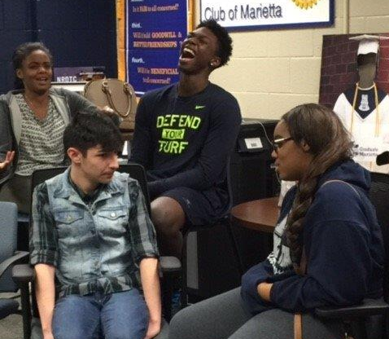
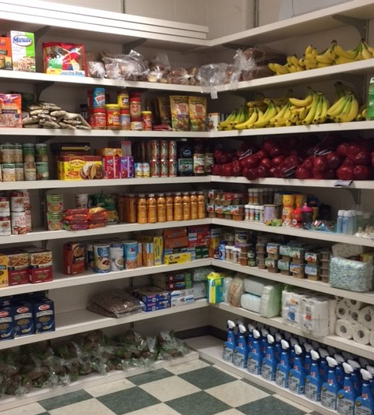
A Prototype of Wraparound Services
For a more detailed view, see ‘Tour a Model’ at www.thecentergyproject.com

Slide 8
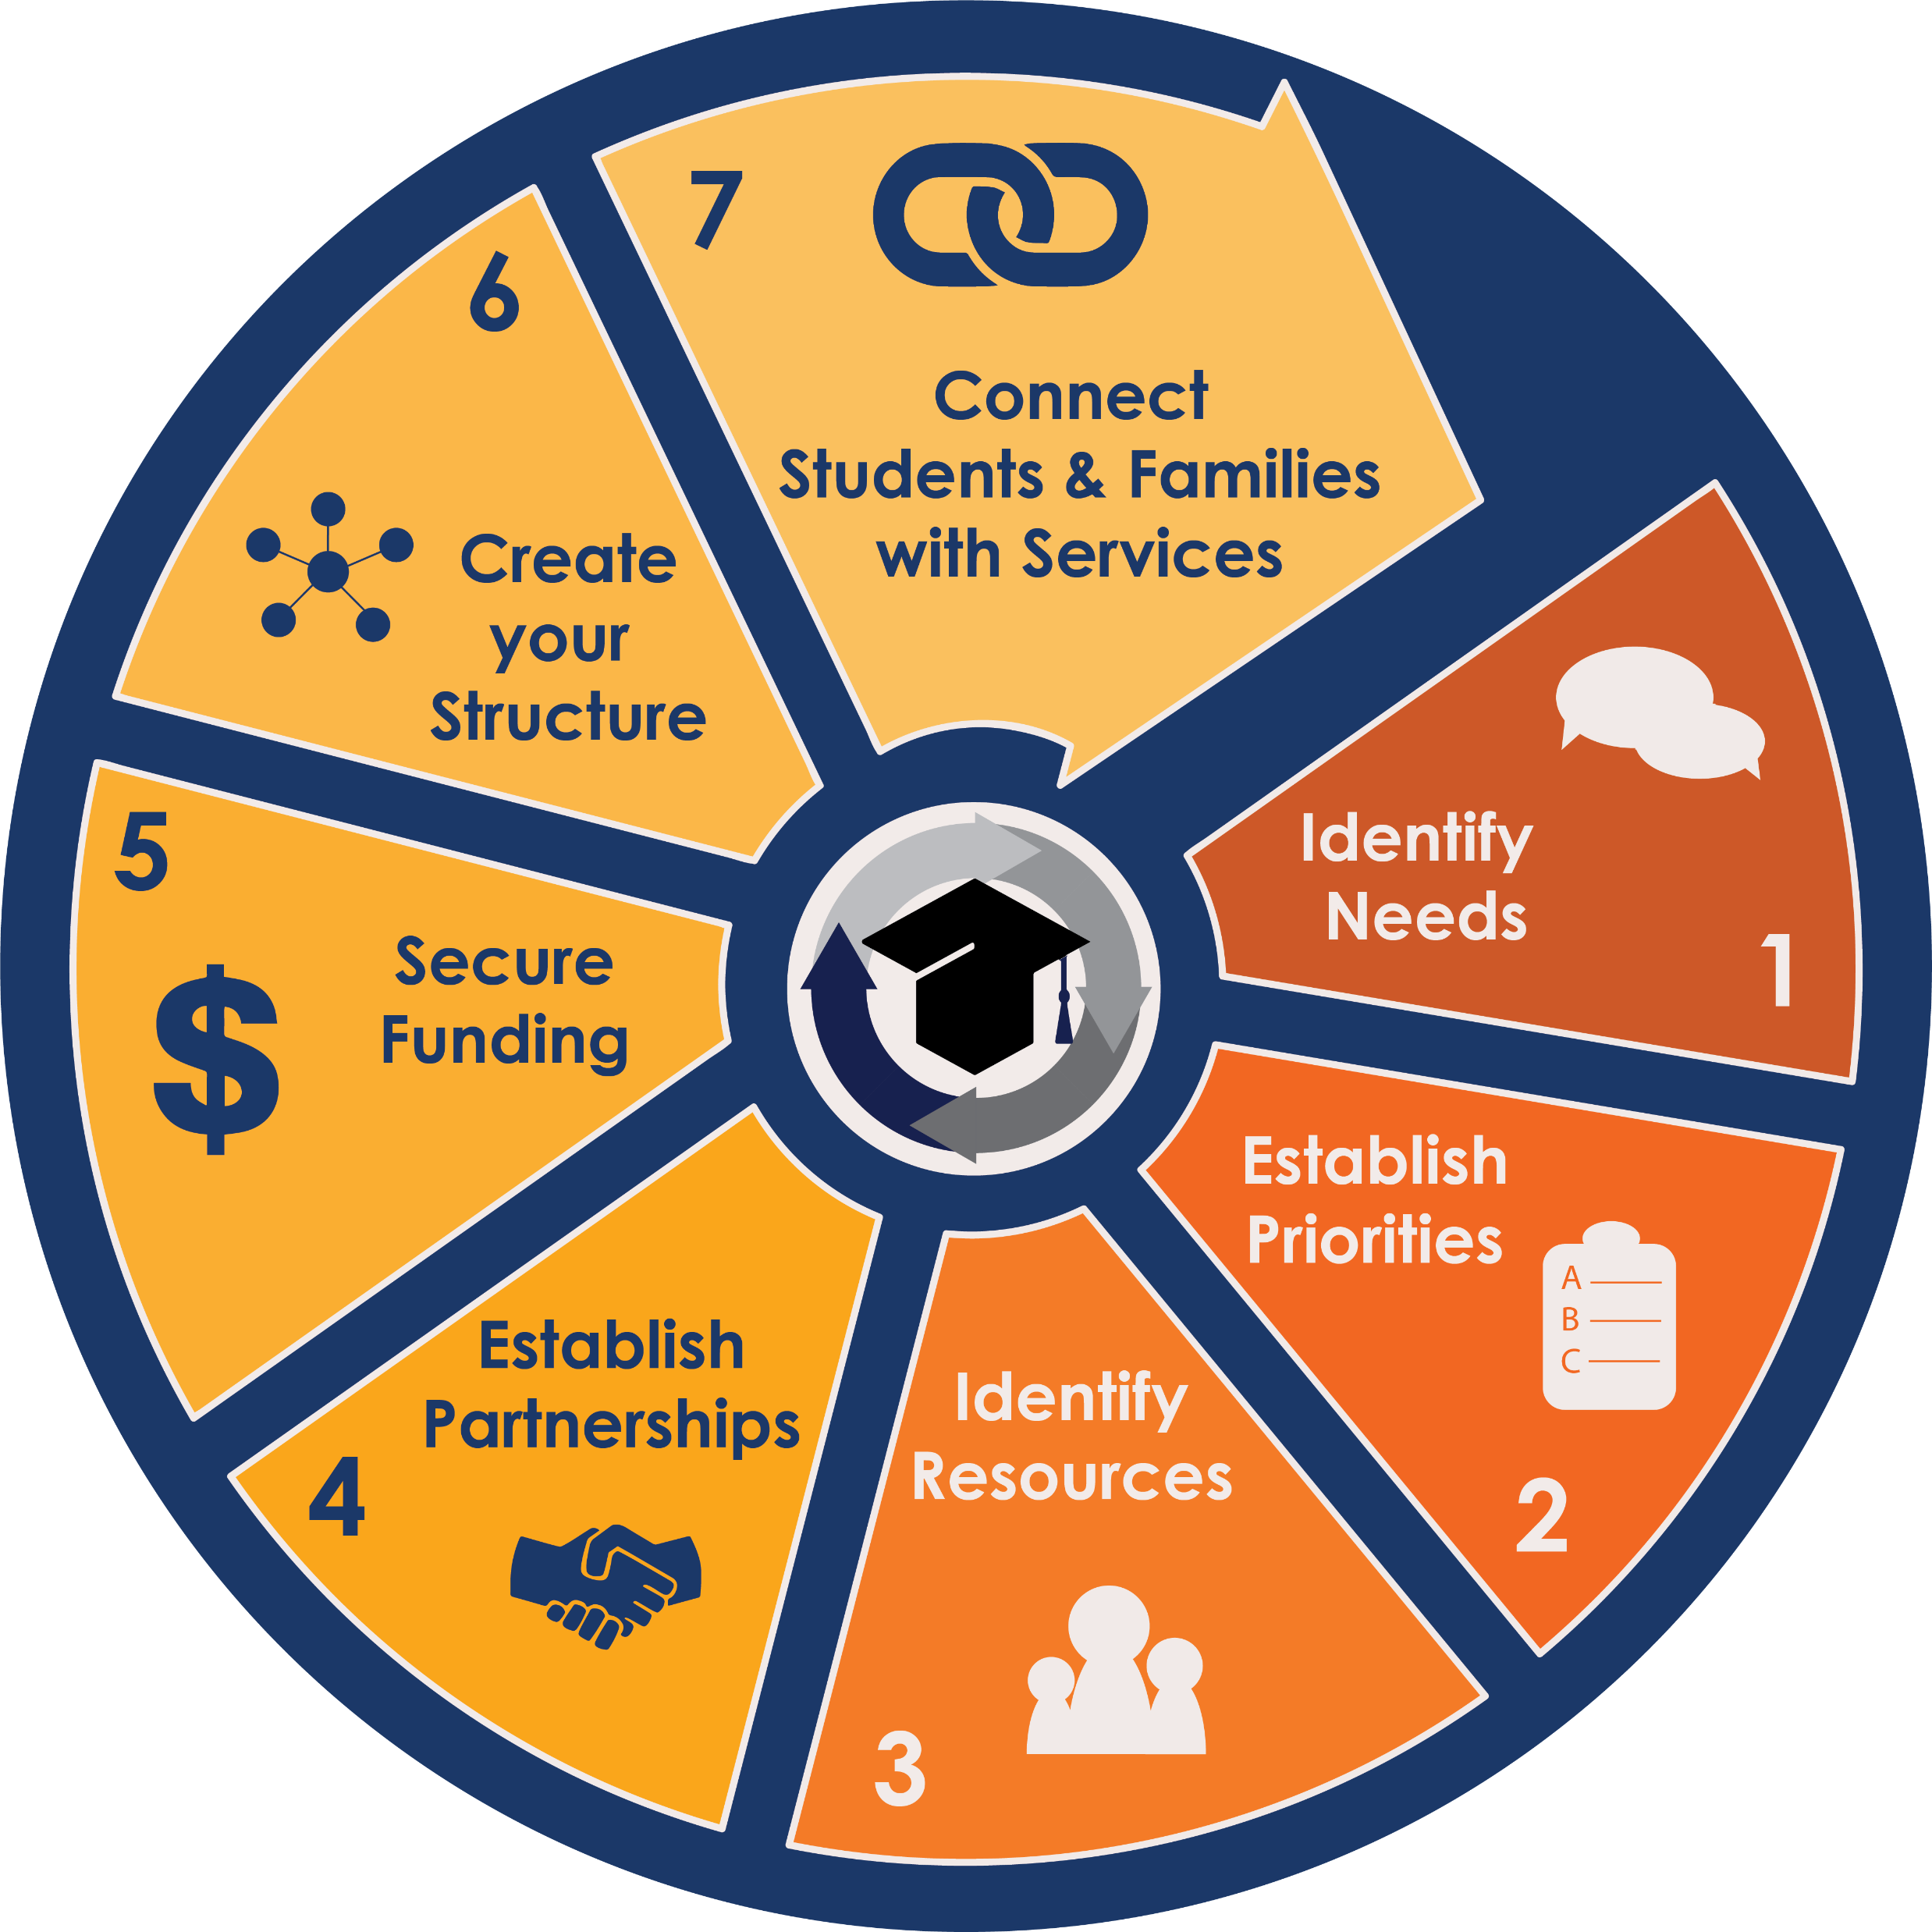
The Centergy Cycle

Slide 9
Gather
Student Voice
Trust
Cultivate Hope
Strengthen Relationships

Slide 10
Phases 1 & 2: Identify Needs & Establish Priorities by Gathering Student Voice
Graduation Stories
Off-track Interviews
Student Needs Assessment
Critical Conversation Groups

Slide 11
A Graduation Story…Seek the Truth
https://www.youtube.com/watch?v=IyYAdt-Qyl4

Slide 12
Off-Track Interviews…Seek the Truth

Slide 14
Student Created Surveys…Speak the Truth

Slide 15
What Support Groups Can You Benefit From?
Self-Esteem – 438 Responses/461
Depression – 387 Responses/381
Mental Health – 302 Responses/201
Wellness and Nutrition – 252 Responses/381
Family Changes – 251 Responses/211
Eating Disorders – 167 Responses/174
Cutting/Self-Harm – 165 Responses/144

Slide 16
Questions to consider…
What brought you here today?
What do you care about?
What helped you back from something difficult?
What gives you hope?

Slide 17
Changing the Paradigms of Poverty
© 2017

Slide 18
OPTIMISM
Barriers are the same, the difference is Resiliency

Slide 19
It all begins with Trust

Slide 20
Use 13 Behaviors to Develop, Restore & Extend Trust
Results
Competence
6. Deliver Results
7. Get Better
8. Confront Reality
9. Clarify Expectations
10. Practice Accountability
Capabilities
Intent
1. Talk Straight
2. Demonstrate Respect
3. Create Transparency
4. Right Wrongs
5. Show Loyalty
Character
Integrity
11. Listen First  12. Keep Commitments  13. Extend Trust
© 2017
© FranklinCovey & Coveylink All rights reserved.

Slide 21
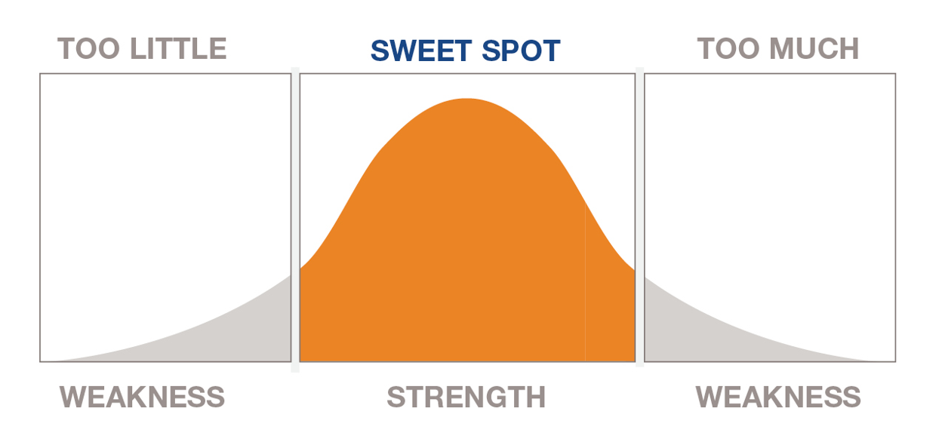
Finding the Sweet Spot
© FranklinCovey & Coveylink All rights reserved.

Slide 22
Finding the Sweet Spot
Friday Night Straight Talk
© FranklinCovey & Coveylink All rights reserved.

Slide 23
Stretch Yourself…confront the BUT
From Consequence focus to Service focus
From Random Acts of Good Intention to Intentional Strategic Partnerships
From Silos to Associations
From External Referrals to Embedded Synergistic Services
From Fear of Liability to Smart Trust
Break the Cage

Slide 24
The Golden Circle
WHAT
HOW
WHY
Simon Sinek’s Golden Circle
Start with 'Why?’

Slide 25
Triangle or Circle?
Institutions
Associations
Defined by Hierarchy
Institutions are defined by…
Control
Production
Consumers
Defined by relationships- non hierarchical
Associations are defined by…
Consensus
Care
Community Members
Notes:
This is a ‘build slide’ when you introduce the change from siloed organization to associations to work for a common mission.
One essential to make the transition from institutions to associations is trust…

Slide 26
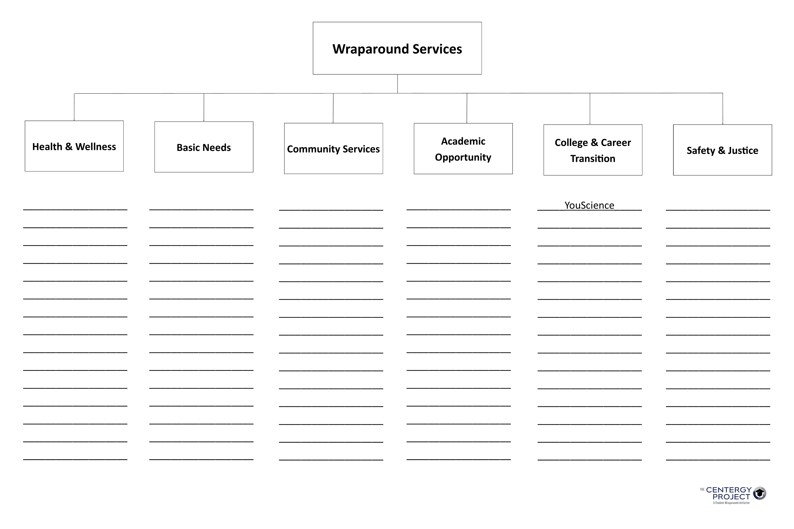
Public Health
Homeless Services
Child Protective Services
Tutoring
College Financial Assistance Planning
Probation and Parole Services

Slide 27
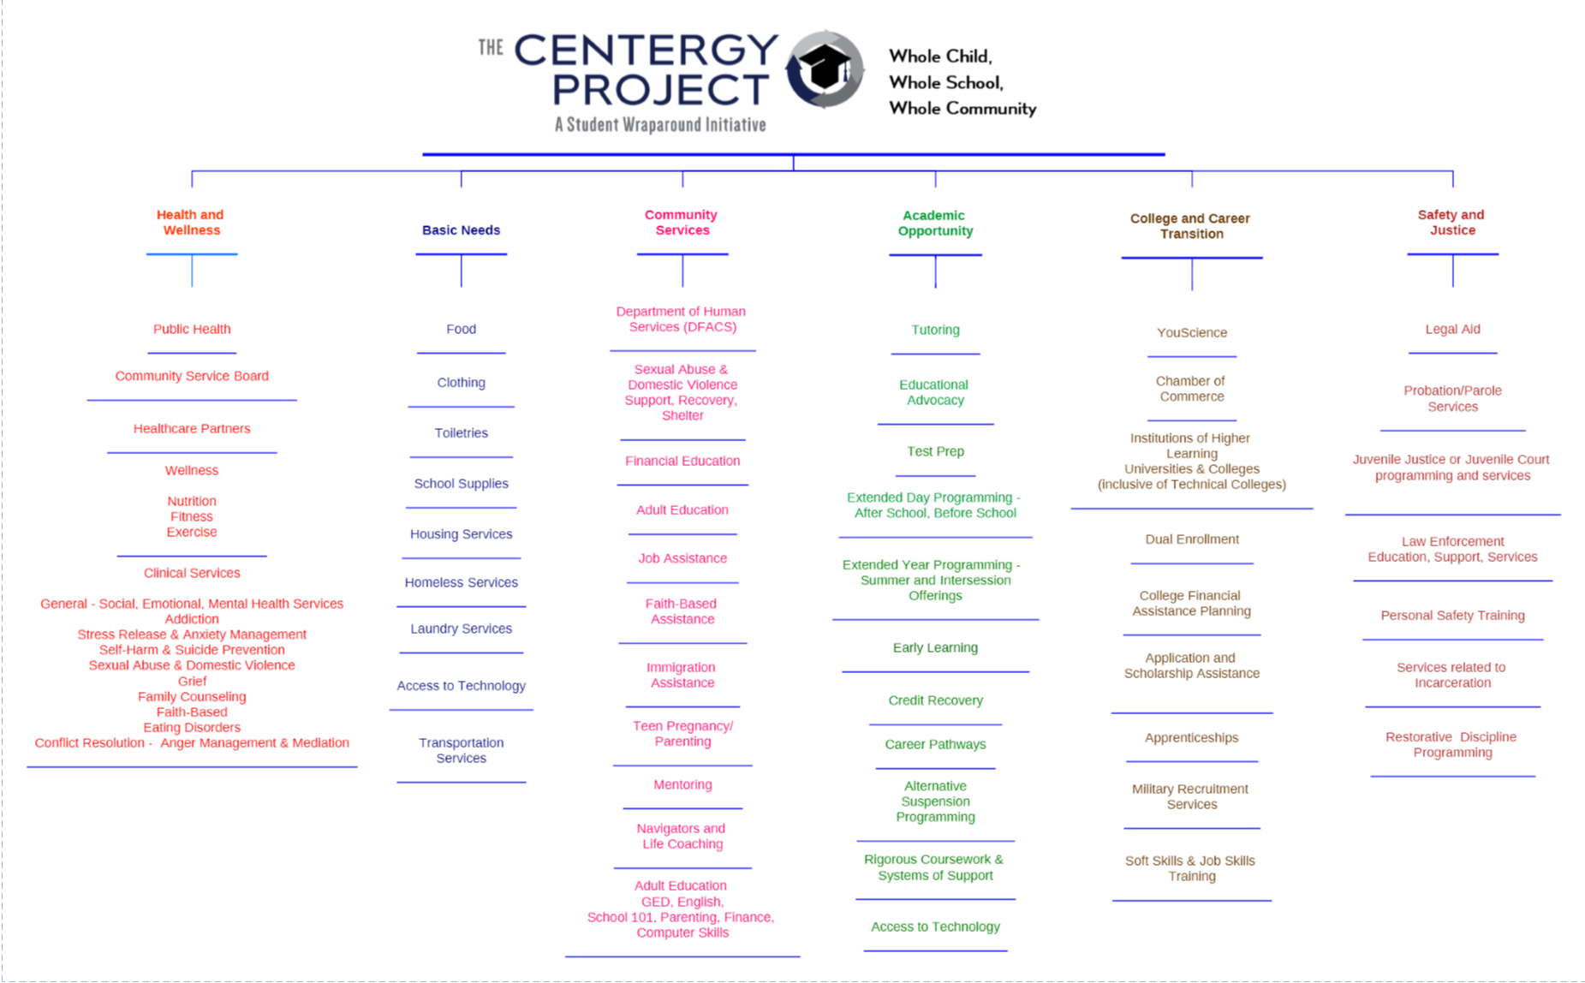

Slide 28
Build Authentic, Enduring Partnerships
Find shared mission
Introduce partner to your school
Determine level of partnership (MOU required?)
Define goals and measurables
Define roles/responsibilities
Leverage the partner’s expertise
Reciprocate the partnership
Establish regular communication
Celebrate your partner
Notes:
Give table groups a few minutes to discuss then facilitate a brief large group discussion.
Transition: our hope is to use collaboration to start a movement. Let’s take look at a few lessons on leadership to help get us started…

Slide 29
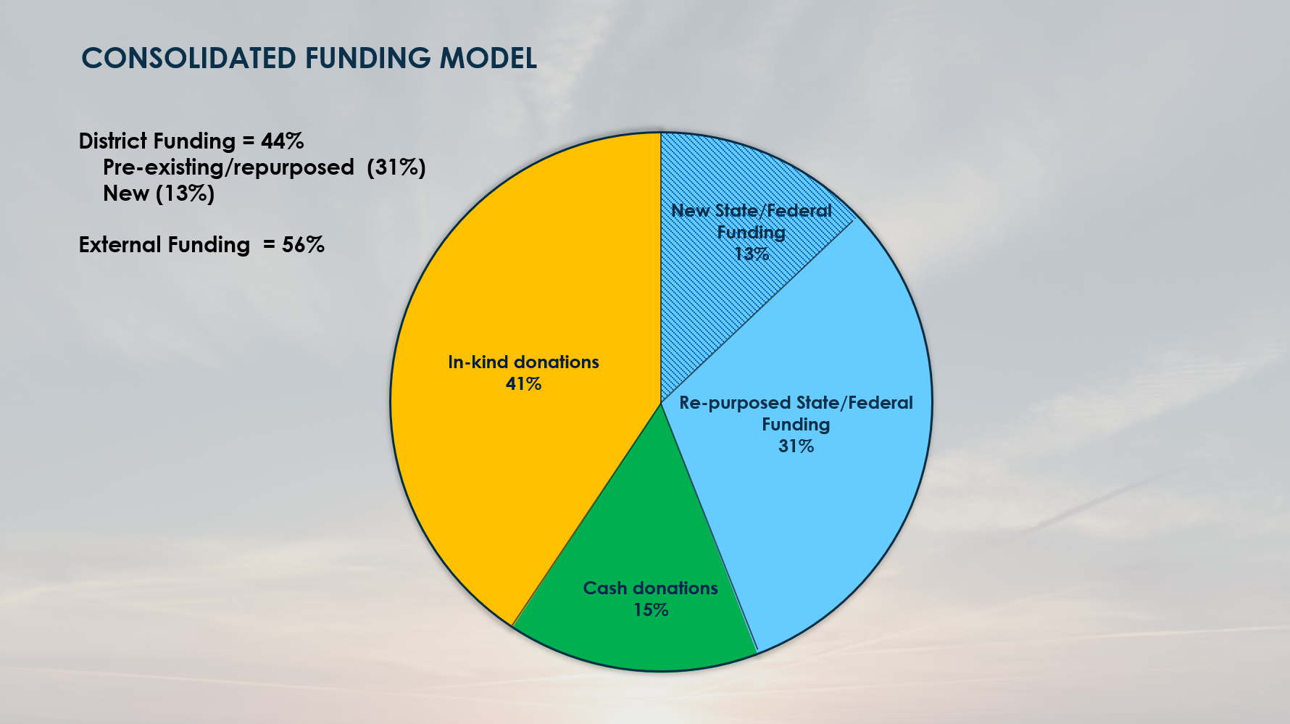
District Added One Position
Value of Services Rendered =
$1.7 million annually

Slide 30
Georgia’s Educational Innovation of the Year, 2016
Staff Composition – 16 staff/agencies on site
Return on Investment – annual ROI is $1.7 million in services rendered
A 44% decrease in suspensions in first 18 months
Graduation Rates are going up – Up 12% since 2013

Slide 31
Ideas for Your Next Steps:
Gather voice
Superintendent/Leader Student Advocacy Council
Review Discipline Data: Look for opportunities for services instead of consequence
Prioritize Community Involvement among Leadership
Seek Collaborative Grant Opportunities
Leverage School Resources for Community Development
Review strategic plan through a lens of social/emotional support

Slide 32
Seek the Truth
Speak the Truth
Stretch Yourself (confront the BUT)
Serve Others
Four Ways to be Brave
Notes:
(note to self – definition of leadership – Develop the Potential of Others, Meet the Needs of Others)

Slide 33
Come to our breakout First Steps and Next Steps and Gathering Voice Asset Mapping – Your District and Community Building Strategic and Enduring Partnerships Including Strategically Connecting with your Chamber to enhance transition for your students -

Slide 34
A culture of Hope
https://www.youtube.com/watch?v=veQAJ4qlltU

Slide 35
leigh@thecentergyproject.com
Visit www.thecentergyproject.com
Password for Exclusive Content: studentvoice

Slide 36
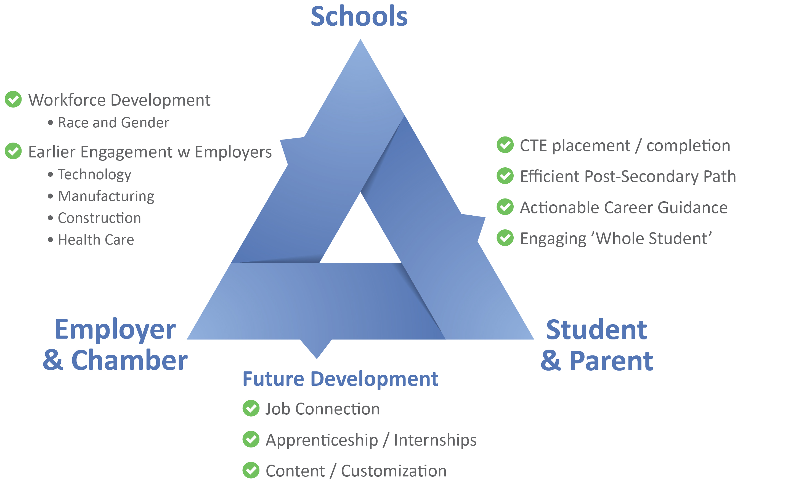
YouScience Platform| Building the Talent Pipeline
Integrated career guidance and analytics to engage students, educators, and employers
SOLVING AMERICA’S WORKFORCE GAP

Slide 37
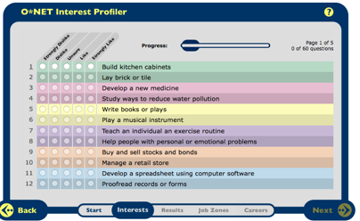
THE CAUSE| Misdirecting Talent
Schools use academic measures (GPA, ACT and SAT) as a proxy for talent.
Career guidance based solely on interest surveys is limited by a student’s exposure.
Yet we all know 100% of students have talent -
and our nation’s economy needs everyone.
Build kitchen cabinets
Buy and sell stocks and bonds
Proofread records or forms
This is particularly damaging to students with a limited vision of opportunity - e.g. low-income, minority, female, and rural students.
SOLVING AMERICA’S WORKFORCE GAP
37

Slide 38
Wrap-Around Partnerships to be Considered
Chamber of Commerce
Child Protective Services
Probation Services
Housing
CARE Closets (Food, Clothing, Toiletries, School Supplies)
Public Health
Nutrition and Wellness
College and Career Advisement
Legal Assistance
Immigration Assistance
Teen Pregnancy/Parenting Services
Local Non-Profits
Clinical Services –
Generalized Social/Emotional/Mental Health
Addiction Services
Sexual Abuse/Domestic Violence
Conflict Resolution/Mediation, Anger Management
Faith Based
Adult/Family Education Services
Job Skills Assistance/Training
Financial Education Classes
Local Law Enforcement and Public Safety Agencies
State and Local Agencies

