Slide 1
Operations and Performance of the Virginia Community College System
January 2018

Slide 2
Research activities
Data analysis
Student outcomes and debt
Tuition and fees
College and system office spending
Structured interviews
Staff at community colleges and VCCS system office
Staff at four-year institutions and SCHEV
K-12 school division staff
Surveys of community college and VCCS system office staff
Document and literature reviews

Slide 3
Student success
Dual enrollment and transfer policies
Community college affordability

Slide 4
JLARC staff analyzed academic outcomes for more than 50,000 students
Seeking a degree or credential
Age 17-19 when entering community college
Earning at least 12 credits in their first year

Slide 5
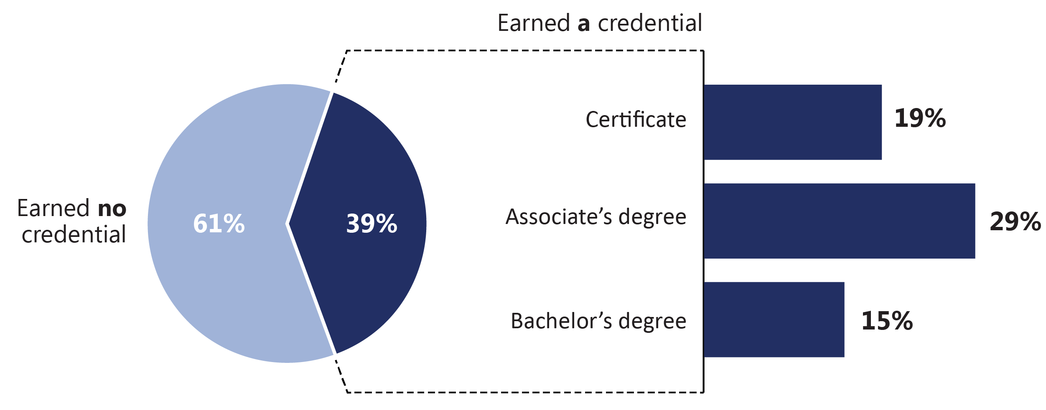
Majority of community college students did not earn a credential
Percentages do not total to 39% as some students obtain more than one type of credential. Does not include students enrolled in non-credit community college programs.

Slide 6
Most students earned more than minimum number of credits needed for a credential
Totals include remedial credits, which do not count toward degrees or credentials.

Slide 7
Identifying college preparedness gaps in high school could improve student success
Nearly two-thirds of students were required to take remedial English or math
Students needing remediation are identified when enrolling in community college
In other states, students needing remediation are identified in high school, and high schools take steps to improve college preparedness

Slide 8
Recommendation
VCCS and VDOE should develop a proposal for (i) administering standardized testing to high school students to determine their college readiness and (ii) improving the college readiness of high school students.

Slide 9
Academic advising can improve student success
Students using advising services are more likely to complete a credential
More engaged
More likely to stay and graduate
Regular, mandatory meetings with an adviser is considered a best practice

Slide 10
Most students do not receive adequate academic advising services
Academic advising is mostly optional, and many students do not use it
Majority of colleges do not require students to meet with advisers at critical times
Advising caseloads are too high to meet student advising needs
21 (of 23) colleges reported advising is difficult to provide

Slide 11
Recommendations
VCCS should develop a
policy for colleges to provide mandatory academic advising services.
proposal for improving colleges’ advising capacity.

Slide 12
Student success
Dual enrollment and transfer policies
Community college affordability

Slide 13
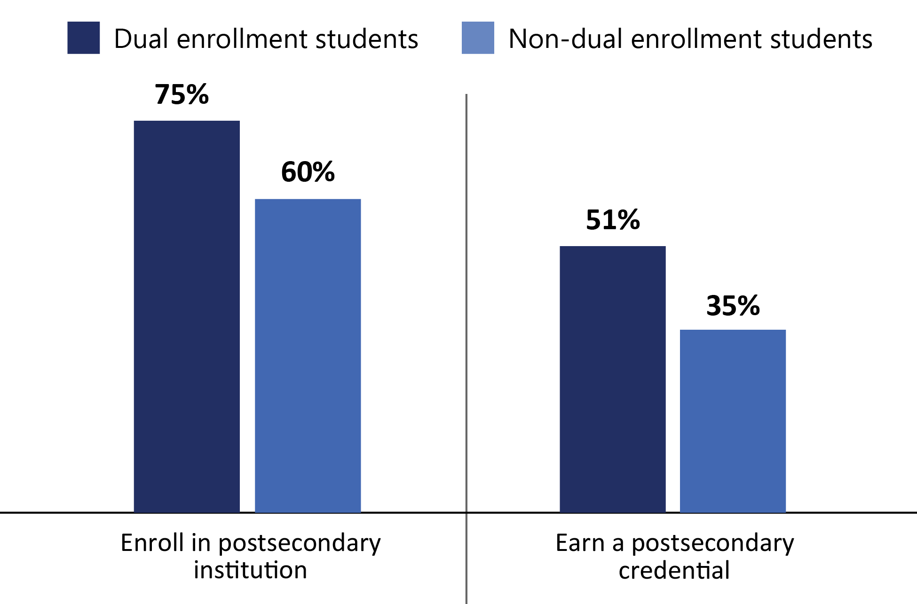
Higher proportion of dual enrollment students enroll in college and earn credentials

Slide 14
Dual enrollment reduces time and cost for students directly entering community college
Compared to non-dual enrollment students, dual enrollment students starting in community college
take 1 less semester to earn associate’s and bachelor’s degrees
accumulate similar number of credits to earn associate’s and bachelor’s degrees

Slide 15
Dual enrollment does not reduce time and cost for students directly entering four-year institutions
Note: 55% of dual enrollment students enter four-year institutions directly from high school.

Slide 16
Four-year institutions are reluctant to accept dual enrollment credits
Four-year institutions express concerns about quality and content of dual enrollment courses
“Students whose dual enrollment course work was taken solely in high school were not prepared for [college-level] course work.” – University staff
Community colleges report student difficulties transferring dual enrollment credits
“Some [four-year] colleges do not want to accept dual enrollment courses as transfer.” – Community college staff

Slide 17
Colleges do not consistently use quality assurance practices for dual enrollment courses
Staff at 16 community colleges reported difficulty ensuring the quality of dual enrollment courses
Colleges do not consistently use nationally recommended quality assurance practices
Classroom observations not consistently conducted by half of colleges
Instructor performance not consistently evaluated by one-third of colleges

Slide 18
Recommendations
The General Assembly may wish to consider requiring public four-year institutions to annually report data that would allow VCCS and SCHEV to identify dual enrollment courses that are not accepted for credit.
VCCS should require community colleges and school divisions to clearly disclose to students which community colleges and programs will accept their dual enrollment credits.
VCCS should coordinate with VDOE to require that community colleges use recommended practices to ensure dual enrollment courses are high-quality.

Slide 19
Difficulty recruiting dual enrollment instructors contributes to program shortcomings
77% of colleges identified recruiting instructors as a challenge
High school instructors must meet minimum credentials
Other states provide financial assistance to help instructors earn credentials
Loan forgiveness
Competitive grants

Slide 20
Recommendation
The General Assembly may wish to consider creating a financial assistance grant program to help high school teachers earn credentials for teaching dual enrollment courses.

Slide 21
Dual enrollment funding model leads to statewide variation in program costs
Statewide variation in
Prices students pay
Program costs to community colleges and school divisions
Administrative costs of program are not covered by existing funding approach

Slide 22
Recommendation
VCCS and VDOE should collect data on dual enrollment expenditures from each community college and school division. This data should be used to develop a single, statewide dual enrollment funding formula and tuition and fee structure.

Slide 23
Transfer students earn bachelor’s degrees at lower rates and accumulate more credits

Slide 24
Transfer students take longer to earn bachelor’s degrees
Transfer students took 1 year longer than non-transfer students
Transfer students took longer at all four-year institutions
Additional credits are roughly equivalent to a full semester
$2,420 in tuition and fees at a community college
$6,780 at the average four-year institution

Slide 25
Transfer process and resources are difficult to use
Transfer agreements have proliferated and are difficult to find
338 identified
Transfer resources maintained on multiple websites
Agreements do not always indicate whether community college credits will be applied to bachelor’s degree requirements
Students may discover that some credits were not applied to degree requirements

Slide 26
Recommendations
The General Assembly may wish to consider requiring
VCCS to maintain a single online repository for all transfer resources, including agreements.
four-year institutions and community colleges to develop more useful transfer agreements consistent with guidelines set by SCHEV.
four-year institutions to keep transfer agreements up-to-date.

Slide 27
Student success
Dual enrollment and transfer policies
Community college affordability

Slide 28
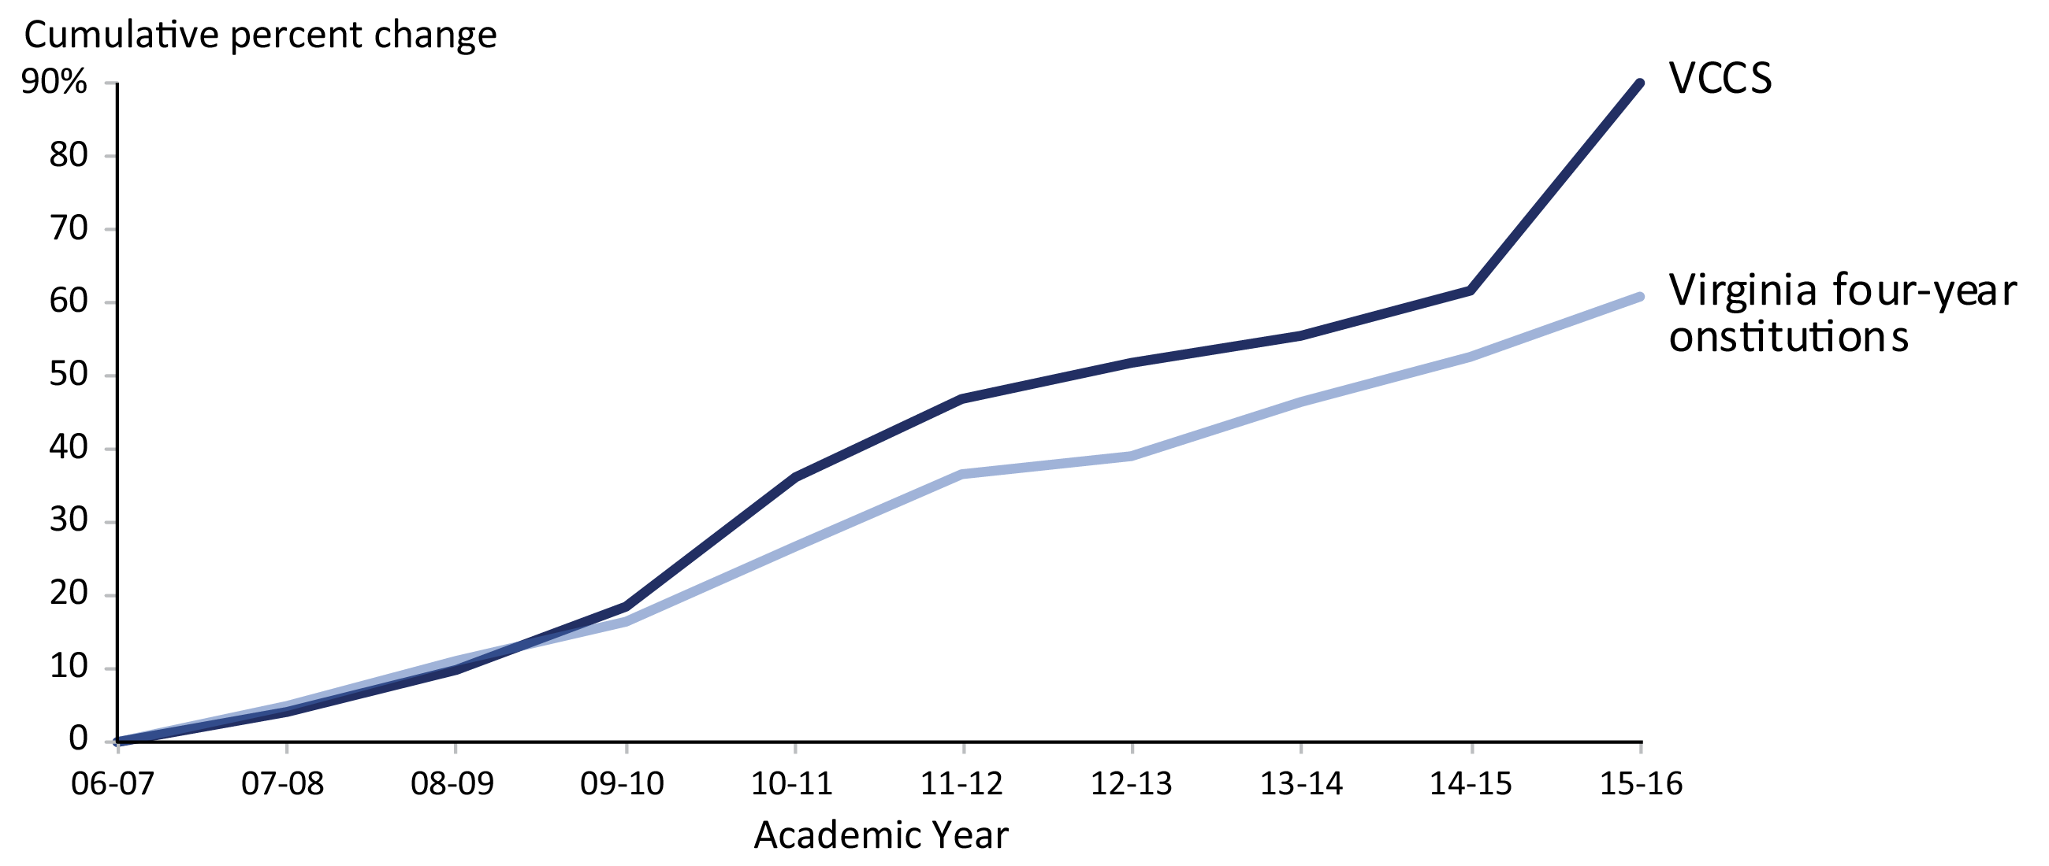
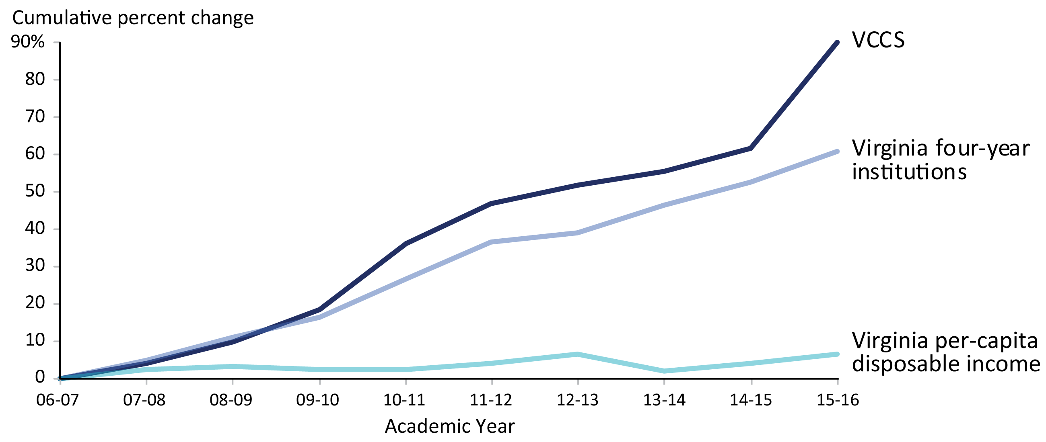
VCCS tuition increased faster than 4-year institutions and per capita income
Adjusted for inflation

Slide 29
VCCS uses metrics that are not relevant to affordability
State Board for Community Colleges considers tuition relative to other states and four-year institutions to evaluate affordability
Boards in other states consider more comprehensive information
Availability of financial aid
Change in net price relative to income

Slide 30
Recommendation
When tuition and fee increases are considered, VCCS staff must present to the State Board for Community Colleges:
Tuition and “net price” relative to income in each college’s service area
Changes in availability of financial aid relative to increases in tuition and fees

Slide 31
QUESTIONS?

