Slide 1
Rising Cost of College Tuition
Algebra I class
Student Sample 1

Slide 2
College Tuition
Tuition is the cost for classes at a university.
Tuition does not include the cost for books, food, or dorms.
Tuition for all colleges is going up every year.

Slide 3
Xavier University
Xavier University is a private university
Xavier is located in Cincinnati Ohio

Slide 4
Harvard University
Harvard is a private Ivy League University
It is one of the oldest universities in the United States
Harvard is located in Cambridge, Massachusetts
Seven U.S Presidents have degrees from Harvard

Slide 5
Tuition cost for Xavier university
Year | Tuition |  | Year | Tuition |  | Year | Tuition
1987 | 5900 |  | 1998 | 13650 |  | 2009 | 26860
1988 | 6450 |  | 1999 | 14400 |  | 2010 | 28570
1989 | 7000 |  | 2000 | 15170 |  | 2016 | 33030
1990 | 7650 |  | 2001 | 16010
1991 | 8645 |  | 2002 | 16870
1992 | 9700 |  | 2003 | 18020
1993 | 10450 |  | 2004 | 19150
1994 | 10970 |  | 2005 | 20400
1995 | 11520 |  | 2006 | 22250
1996 | 12270 |  | 2007 | 23670
1997 | 12950 |  | 2008 | 24600

Slide 6
Tuition cost for Harvard university
Year | Tuition |  | Year | Tuition |  | Year | Tuition
1987 | 11390 |  | 1998 | 21266 |  | 2009 | 36173
1988 | 12015 |  | 1999 | 22028 |  | 2010 | 37012
1989 | 12715 |  | 2000 | 24407 |  | 2016 | 43938
1990 | 13545 |  | 2001 | 25128
1991 | 14450 |  | 2002 | 26019
1992 | 15410 |  | 2003 | 27448
1993 | 16454 |  | 2004 | 29060
1994 | 17470 |  | 2005 | 30620
1995 | 18485 |  | 2006 | 32097
1996 | 19472 |  | 2007 | 33709
1997 | 20242 |  | 2008 | 34998

Slide 7
National Average Tuition cost for Private university
Year | Tuition |  | Year | Tuition |  | Year | Tuition
1987 | 8118 |  | 1998 | 17229 |  | 2009 | 26927
1988 | 8771 |  | 1999 | 18340 |  | 2010 | 28524
1989 | 9451 |  | 2000 | 19307 |  | 2011 | 29300
1990 | 10348 |  | 2001 | 20106 |  | 2012 | 29454
1991 | 11379 |  | 2002 | 21176 |  | 2013 | 30197
1992 | 12037 |  | 2003 | 22716 |  | 2014 | 30783
1993 | 13055 |  | 2004 | 24128 |  | 2015 | 21226
1994 | 13874 |  | 2005 | 25643 |  | 2016 | 32405
1995 | 14537 |  | 2006 | 26162
1996 | 15605 |  | 2007 | 26774
1997 | 16552 |  | 2008 | 26883

Slide 8
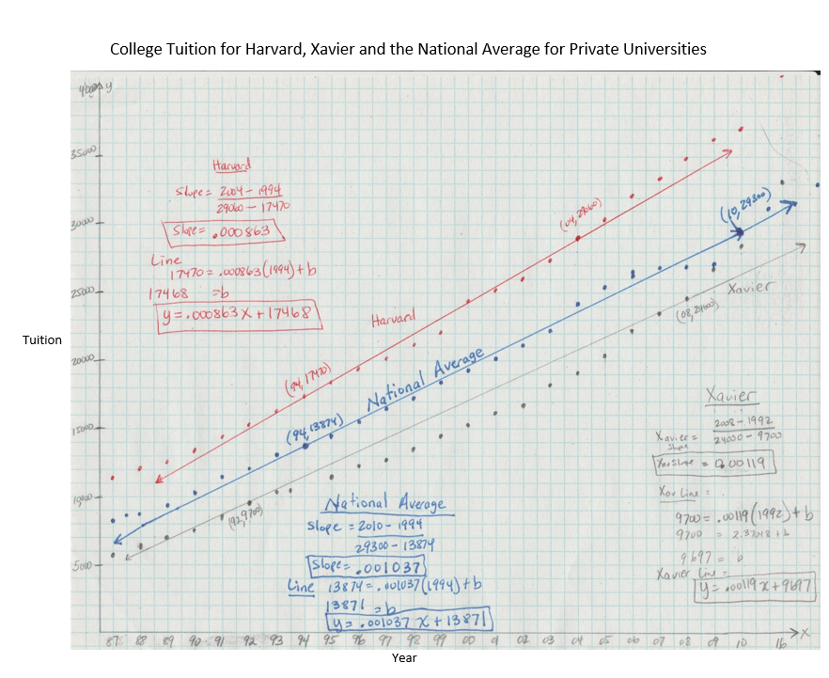
Xavier University:
Slope = 0.00119
Equation of Line:
y = 0.00119x + 9697
Harvard University:
Slope = 0.000863
Equation of Line:
y = 0.000863x + 17468
National Average:
Slope = 0.001037
Equation of Line:
y = 0.001037x + 13871

Slide 9
What does the line represent?
The line in the graph represents the line of best fit for the data in the scatterplot.
The slope of the line shows how much (on average) the tuition increases each year.
It is increasing because the slope is positive

Slide 10
How to Predict the tuition for when I go to college
To be able to predict the tuition for when I go to college I need to use the equation of the line and substitute in for the years I will go to college (2019, 2020, 2021, and 2022) in for x and solve for y.
I first found the slope of the line by subtracting the x and y values and dividing.
I then found the y-intercept by using a know value and the slope and solving for “b”.
The equations for the lines for each university is:
Xavier: y = 0.00119x + 9697
Harvard: y = 0.000863x + 17468
National Average: y = 0.001037x + 13871

Slide 11
Prediction for cost of Tuition when I go to College
Xavier University
Harvard University
National Average
y = 0.00119x + 9697
2019: $9699.40
2020: $9699.41
2021: $9699.41
2022: $9699.41
y = 0.000863x + 17468
2019: $17469.74
2020: $17469.74
2021: $17469.74
2022: $17469.74
y = 0.001037x + 13871
2019: $17469.74
2020: $17469.74
2021: $17469.74
2022: $17469.74
I know these numbers cannot be correct because they are less than the tuition in 2015. I have checked my math and the steps I used to find the equation but cannot find a mistake.

Slide 12
Best Financial Choice
The best financial choice is Xavier University.
The tuition for Xavier University is below both Harvard and the National Average tuition for a private university.
The tuition at Harvard University actually increases less each year than either Xavier or the National Average. However, the tuition for Harvard in 2015 is $10,908 more than the tuition at Xavier.
I would save a total of $31,081.33 by attending Xavier University for four years rather than Harvard.

