Slide 1
Strategies to Increase State Funding for Public Education in Virginia VASS Fall Conference October 22, 2019
Rachael C. Deane
Legal Director , JustChildren Program

Slide 2
About Legal Aid Justice Center
Anti-poverty legal organization with 4 offices statewide
Four main programs in the areas of economic justice, immigrant advocacy, civil rights & racial justice, and education advocacy

Slide 3
JustChildren Program
"Virginia will achieve equity when a student's zip code or poverty level doesn't predict achievement." - Virginia Board of Education, Annual Report on the Conditions and Needs of Public Schools in Virginia, 2018
Notes:
We seek to ensure that every child in the Commonwealth has access to a high-quality education, with a focus on low-income children, who face persistent achievement gaps and who overwhelmingly attend schools in low-wealth divisions
"Virginia will achieve equity when a student's zip code or poverty level doesn't predict achievement." - Virginia Board of Education, Annual Report on the Conditions and Needs of Public Schools in Virginia, 2018

Slide 4
What’s the Big Deal About Funding?
Aggregate measures of per-pupil spending are positively associated with improved or higher student outcomes
School resources that cost money are positively associated with student outcomes
On the whole, money matters in education.
Bruce Baker, Does Money Matter in Education? 2nd Ed.
Notes:
I don’t think I need to convince anyone in the room that money matters when we’re talking about school funding, but here we go anyway: On the whole, money matters in education. After some negative research in the 1980s, study after study of sustained, long-term investments in education show that there’s a positive association between increased funding and improved student outcomes.
On average, aggregate measures of per-pupil spending are positively associated with improved or higher student outcomes. I’m using Bruce Baker’s excellent review of the research here, called Does Money Matter in Education. He notes that the size of this effect is larger in some studies than in others, and, in some cases, additional funding appears to matter more for some students than for others. Of course there are other factors that may moderate the influence of funding on student outcomes, such as how that money is spent. But, on balance, in direct tests of the relationship between financial resources and student outcomes, money matters.
School resources that cost money also matter. Here the research is referring to resources such as smaller class sizes, early childhood programs, and more competitive teacher compensation. Again, in some cases, those effects are larger than in others, and there is also variation by student population and other contextual variables. On the whole, however, the things that cost money benefit students, and there is scarce evidence that there are more cost-effective alternatives.
Do state school finance reforms matter? Yes. Sustained improvements to the level and distribution of funding across local public school districts can lead to improvements in the level and distribution of student outcomes.

Slide 5
What Is Fair School Funding?
A sufficient level of funding…
Distributed to account for student poverty
Notes:
When we talk about school funding systems, we want to make sure they are fair. What is a fair system?
According to the Education Law Center, one of the foremost research and advocacy organizations working on this issue, “fair” school funding is defined as a
state finance system that ensures equal educational opportunity by providing a sufficient
level of funding that is distributed to districts within the state to account for additional
needs generated by student poverty.
Baker, Sciarra, Farrie, National Report Card: Is School Funding Fair? www.schoolfundingfairness.org

Slide 6
Fair School Funding
A “progressive” finance system allocates more funding to districts with high levels of student poverty
A “regressive” system allocates less to those districts
A “flat” system allocates roughly the same across districts with varying needs
Education Law Center, Is School Funding Fair?, 7th Ed.
Notes:
Core principles: States should provide varying levels of funding to ensure equal educational opportunities to children with different needs.
A “progressive” finance system allocates more funding to districts with high levels of student poverty
A “regressive” system allocates less to those districts
A “flat” system allocates roughly the same across districts with varying needs

Slide 7
Virginia Schools Are Underfunded
State level support for K-12 education in Virginia has not returned to pre-recessionary levels.
Local governments continue to take on a larger share of funding: $4.0 billion above the required local effort for SOQ programs in 2016-17.
Virginia’s high poverty divisions receive 89 cents for every dollar as compared to low poverty divisions.
Notes:
And if money matters in general, it REALLY matters when you haven’t had enough for a long time. And that’s the situation in Virginia.
The truth is that Virginia’s schools are underfunded and are not fairly funded. We have neither an adequate statewide level of funding nor an adequate system for distributing funds to account for student poverty. Under the model on the previous slide, we’re considered a regressive system.
There is a lot of good material out there, including from The Commonwealth Institute for Fiscal Analysis, about how underfunded Virginia schools are. But we really need only to turn to last year’s Annual Report from the Virginia Board of Education on the Conditions and Needs of Virginia’s Public Schools. That report noted persistent achievement gaps for certain students groups, particularly economically disadvantaged students, and detailed the state of school funding in Virginia. The report found that:
State level support for K-12 education has not returned to pre-recession levels. According JLARC, Virginia ranks 24th of 50 states for state and local per pupil funding for Pre K-12 education, and 40th of 50 states for state per pupil funding. There has been some slight progress in the legislature, but it is nowhere near enough to dig us out of this hole. State support is still down 9.1 percent per student for the 2018-2019 school year in real dollars compared to 2008-2009.
Local governments continue to take on a larger share of funding. In 2016-2017, Virginia localities invested $4.0 billion above the required local effort for SOQ programs. However, not all localities have the capacity to provide additional investments causing inequitable resources and learning opportunities for students.
Students in high-poverty schools have less experienced teachers, less access to courses, and lower levels of spending on teachers and instructional materials.
Our system is regressive. Despite serving students who often need additional supports and services, Virginia’s high poverty divisions receive 89 cents for every dollar as compared to low poverty divisions. Average student outcomes similarly lag in high poverty divisions.
Baker, Farrie, Sciarra.s/Is_School_Funding_Fair_7th_Editi.pdf.

Slide 8
Education Law Center, Is School Funding Fair?, 7th Ed.
Funding level, 20% poverty
Notes:
I have a few charts to illustrate both the inadequate level of funding in Virginia and the inadequate distribution of funding relative to student poverty. These come from the Education Law Center, which publishes a very good national survey of school funding trends in the states. Virginia is doing a middling-to-poor job, and if we have to assign a grade, it’s somewhere between a C and and F, depending on what we’re measuring. Here we have a chart just showing the per-pupil funding level at 20% poverty (which is the national average)—Virginia is in the middle of the pack here, spending a little under $9,000 per student at this poverty level. Just to note this is a model constructed by the Education Law Center to compare states across the country, so it controls for student poverty, regional wage variation, and school district size and density.

Slide 9
Funding Distribution
Education Law Center, Is School Funding Fair?, 7th Ed.
Notes:
And in terms of fairness, here’s a map showing how we stack up—Virginia is depicted here as having a regressive finance system

Slide 10
Notes:
Nationwide, we’re in the midst of campaigns to increase state funding for public K-12 education.
These campaigns are organized and joined by a variety of constituencies: teachers, students, parents, administrators, and others who support public ed.
These campaigns are built on diverse coalitions of supporters and use a variety of strategies: policy and legislative advocacy, litigation, and community organizing and direct action – Here I have pulled photos and graphics from current, ongoing campaigns in Michigan, Pennsylvania, Massachusetts, New Mexico, North Carolina, and Illinois.

Slide 12
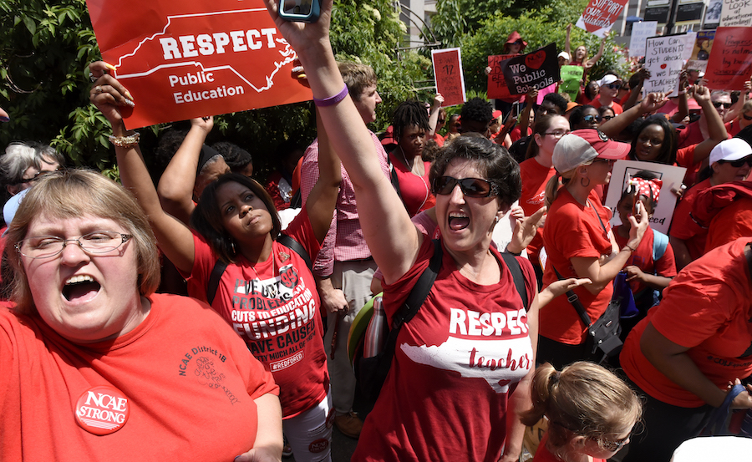
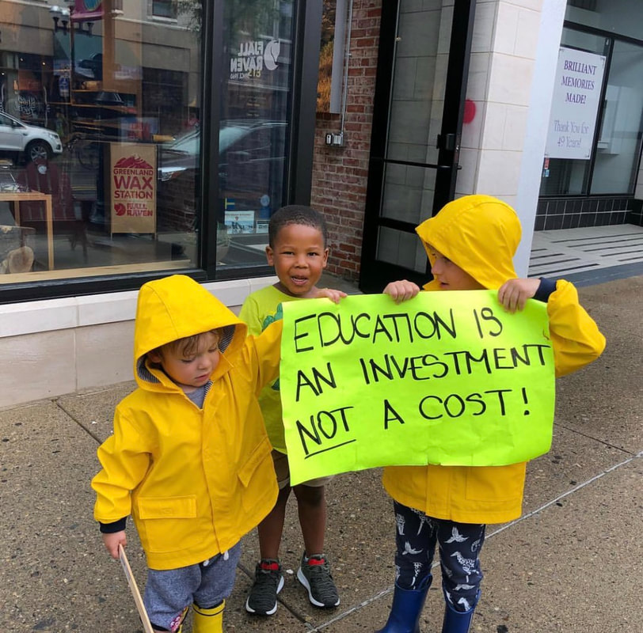

Slide 13
Across the Nation: Campaigns to Increase K-12 School Funding
Diverse coalition of supporters
Costing-out studies
Fiscal expertise
Urban + rural
Accounting for poverty
Litigation
Notes:
These campaigns share many of the same opportunities and strategies:
Built on diverse coalitions, with essential support from all groups that make up the public education community: students, parents, teachers, superintendents and school boards, and localities. Look no further than the #RedforEd movement to see the power of involving diverse groups.
Depending on the current budget situation, some of the campaigns either demand a costing-out study to determine the true cost of public education statewide, or they are able to craft specific budget demands based on a costing-out study that has been performed
Draw upon the expertise of fiscal analysts, particularly around options for increasing revenue
The campaigns unite diverse geographies across each state, particularly urban areas and rural areas, which generates strong political pressure, in part because—
They account for the student needs generated by poverty, highlighting the unique challenges in public education for economically disadvantaged youth and the additional staffing and supports needed to meet these needs
And some of the campaigns have a litigation component

Slide 14
Across the Nation: Campaigns to Increase K-12 Funding
Teacher salary increases
Additional funding weight for at-risk students
Additional instructional time
Additional staffing and support positions
Notes:
The other aspect these campaigns share is that THEY ARE WORKING. The improvements to funding do not happen all at once, but the advocacy generated by these campaigns has positively affected school funding, for example:
In New Mexico, late least year a state court judge found that the state was not meeting its constitutional obligation to provide an adequate education to all students in New Mexico, particularly Native American students and English Learners, and also that a 10% extra weighting for at-risk students wasn’t adequate. The judge issued an order requiring the state to enact school finance reforms to ensure that every public schools had adequate resources to provide a sufficient education to all at-risk students. During this year’s legislative session, the Governor and legislature agreed on a deal to increase teacher salaries by 6%, extend instructional time, and raise the at-risk weight to 18%. The campaign is now working to ensure additional funding.
In Maryland, a commission tasked with examining school funding contracted for a funding adequacy study and issued major recommendations around adequacy and equity in school funding. This year, the legislature approved $350 million as an initial investment, with a plan for $2.9 billion over 10 years.
This spring in Kansas, the Governor signed an education bill that will add $90 million per year over the next four to the education budget, and this comes after last year’s bill that already added $525 million in a five-year phase-in.

Slide 15
State Funding in Our Own Backyard
2019 Standards of Quality
$950 annually
Equity Fund
Specialized Support Position Personnel
Counselors
Reading Specialists
Class Size Reduction
Notes:
Again, I know that our funding concerns are not news to this group of educators. You all know the specific funding concerns in your school division, the unique needs of your students and the limitations of your local funding capacity, and the way our current funding formula affects your ability to properly staff your schools. I want to turn to the present moment to discuss the opportunities and strategies we have to increase school funding right here in Virginia.
Last week, the Virginia Board of Education prescribed new Standards of Quality for our K-12 schools—at an estimated cost of about $950 million annually for the state funding portion. The new Standards of Quality come after the Board has spent the past two years studying the achievement gaps across the state and the needs of students in poverty. The Board has decided that Virginia must, both legally and morally, address school funding, with a particular eye to equity.
Here I have pulled out some of the Standards most closely related to addressing the needs of students in poverty and at addressing equity, but this is not all of the standards. The Board is also requesting that the GA lift the support cap
And in a break from its practice in years past, the Board actually issued a Resolution prescribing these Standards--

Slide 16
Resolution Prescribing Standards of Quality
Since 1988, “The General Assembly has passed 197 bills amending the Standards of Quality, the overwhelming majority of which were unrelated to the Standards of Quality as prescribed by Board of Education pursuant to its constitutional authority.”
Comprehensive plan requires high-quality, effective learning environments; supporting teacher recruitment, development, and retention; and implementation of the Profile of a Virginia Graduate
“The Board of Education has undertaken a two-year process, reviewing and researching evidence-based best practices and engaging in significant public engagement to make data-driven policy decisions to revise the Standards of Quality to provide support for Virginia educators and better ensure equity of opportunity and outcome for Virginia’s students.”
Notes:
And in a break from its previous practices, the Board issued a Resolution prescribing these standards, with forceful language about both its intent and the importance of the standards themselves
WHEREAS, since the 1988 action, the General Assembly has passed 197 bills amending the Standards of Quality, the overwhelming majority of which were unrelated to the Standards of Quality as prescribed by Board of Education pursuant to its constitutional authority; and
WHEREAS, the Board of Education’s 2018-2023 Comprehensive Plan, establishes three priorities for public education in Virginia:
Priority 1: Provide high-quality, effective learning environments for all students;
Priority 2: Advance policies that increase the number of candidates entering the teaching profession and encourage and support the recruitment, development, and retention of well-prepared and skilled teachers and school leaders; and
Priority 3: Ensure successful implementation of the Profile of a Virginia Graduate and the accountability system for school quality as embodied in the revisions to the Standards of Accreditation.
WHEREAS, since the adoption of the Comprehensive Plan, the Board of Education has undertaken a two-year process, reviewing and researching evidence-based best practices and engaging in significant public engagement to make data-driven policy decisions to revise the Standards of Quality to provide support for Virginia educators and better ensure equity of opportunity and outcome for Virginia’s students;

Slide 17
Article VIII, Section 1
The General Assembly shall provide for a system of free public elementary and secondary schools for all children of school age throughout the Commonwealth, and shall seek to ensure that an educational program of high quality is established and continually maintained.
Notes:
The fact is that the state DOES have a legal obligation to fund high-quality schools: it’s written in our State Constitution.

Slide 18
Article VIII, Section 2
Standards of quality for the several school divisions shall be determined and prescribed from time to time by the Board of Education, subject to revision only by the General Assembly. The General Assembly shall determine the manner in which funds are to be provided for the cost of maintaining and educational program meeting the prescribed standards of quality, and shall provide for the apportionment of the costs of such program between the Commonwealth and local units of government comprising such school divisions.

Slide 19
Scott v. Commonwealth (1994)
“[E]ducation is a fundamental right under the [Virginia] Constitution.”
“[T]he Constitution requires the General Assembly to determine the manner of funding to provide the cost of maintaining an educational program that meets the prescribed standards of quality . . . ”

Slide 20
Time for a Virginia Campaign
2003
Alliance for Virginia’s Students created in 2003 as a 501(c)(4)
2006-08
2010
Alliance defended At-Risk Add-On
2012
Alliance called for VBOE to recommend adequacy study
2013
Alliance helped to pass a legislative study of school funding adequacy
2016
Alliance held retreat to discuss possibility of litigation
2017
LAJC concluded significant resources necessary to pursue full campaign & litigation
2017–19
Alliance fought for elimination of support cap & increase to ARAO
Alliance helped lead broad coalition to secure additional funding for VPI & continued to defend program from cuts
Notes:
Alliance for Virginia’s Students created in 2003 to build a statewide, grassroots advocacy network that promotes state policies and financial support that are necessary for excellence in public education from pre-kindergarten through graduate studies.
Over the years, the Alliance has won increased state support for public education and protected funding for programs serving at-risk students. Our most significant accomplishments include:
• In 2013, the Alliance helped pass a legislative study of the adequacy/equity of school funding statewide.
• In 2012, the Alliance submitted a statement to the Board of Education calling for a legislative study of the adequacy and equity of school funding. The statement was endorsed by ten statewide organizations and over 1,220 individuals, hundreds of whom submitted personalized comments. The Board recommended the study and, thanks to the work of the Alliance’s partners, the study was approved by the General Assembly.
• In 2010, the Alliance and its partners successfully defended programs serving at-risk students from proposals that would have redistributed funds to school divisions based on student population rather than student poverty.
• In 2006 and 2008, the Alliance helped lead a broad-based coalition to secure additional funding for the expansion of the Virginia Preschool Initiative, which serves thousands of at-risk four-year-olds across the Commonwealth. In recent years, we have successfully defended the preschool program from proposed cuts.

Slide 21
Campaign Next Steps
Campaign launch this fall
Governor's proposed budget
Onward to General Assembly session

Slide 22
Supporting the Campaign
Join our campaign coalition
Personal stories
Legislative strategy and engagement
Public engagement and media support

Slide 23
Brown v. Board of Education (1954)
“In these days, it is doubtful that any child may reasonably be expected to succeed in life if he is denied the opportunity of an education.”
Notes:
“Today, education is perhaps the most important function of state and local governments. Compulsory school attendance laws and the great expenditures for education both demonstrate our recognition of the importance of education to our democratic society. It is required in the performance of our most basic public responsibilities, even service in the armed forces. It is the very foundation of good citizenship. Today it is a principal instrument in awakening the child to cultural values, in preparing him for later professional training, and in helping him to adjust normally to his environment. In these days, it is doubtful that any child may reasonably be expected to succeed in life if he is denied the opportunity of an education.”

Slide 24
Questions?
Rachael Deane
Legal Director, JustChildren Program
Legal Aid Justice Center
rachael@justice4all.org
804.873.0783 (mobile)

