Slide 1
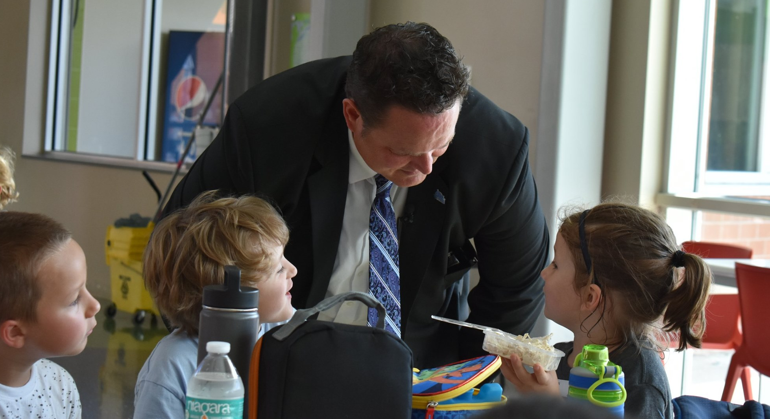
2020-2021
Virginia Superintendents’ Leadership Academy
OCTOBER 2019
https://www.vassonline.org/

Slide 2
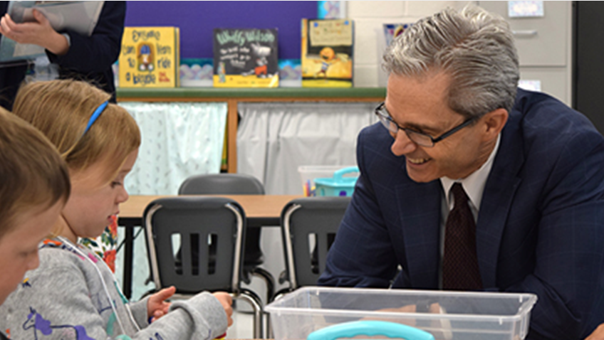
The Virginia Superintendents’ Leadership Academy
A12 month program limited to approximately
12 acting Virginia superintendents per year
who desire to serve as leading innovative change agents.
The Academy will base its curriculum
on the acquisition of leadership
competencies in the
Profile of a Virginia Leader
essential to better prepare Virginia’s
students for their futures.
Presented to the Virginia Board of Education on July 1, 2019
Superintendent
EMPOWERMENT
Innovation
The VSLA will incorporate elements of the
American Association of School Superintendents’
national models for superintendent professional
development that serve as the basis for AASA’s
Leadership Academy and National Superintendent Certification Program.
Change Agents
VASS is sponsoring a competency-based training program for Virginia superintendents who wish to develop the knowledge and skills of innovative education leaders to successfully implement reforms in their school divisions and more specifically the changes needed to implement the Profile ​
of a Virginia Graduate. ​
Leaders of Deeper
Learning
October 2019

Slide 3
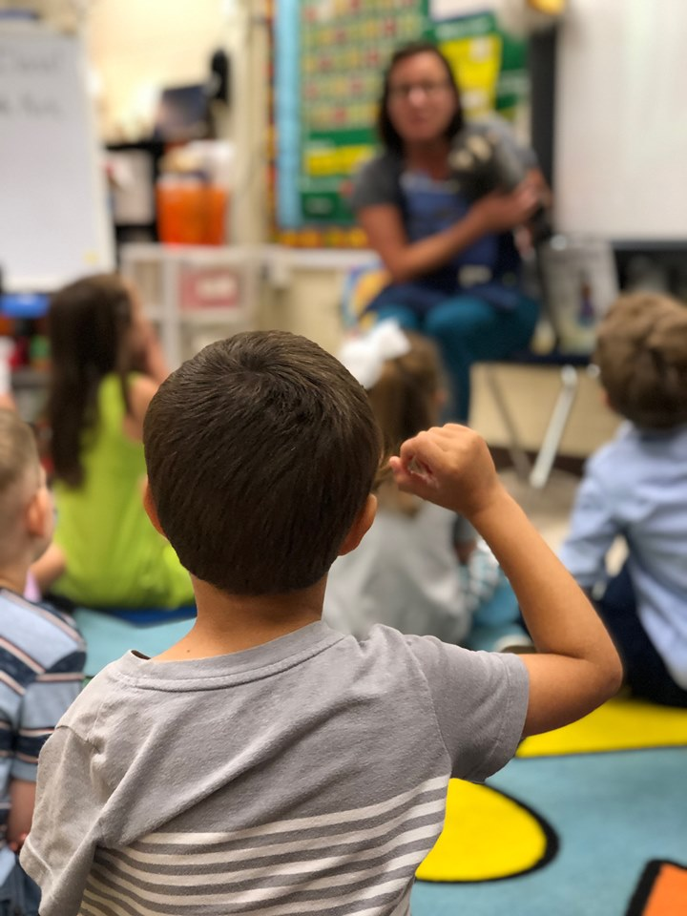
VSLA Collaborative Model
Commonwealth Partners
VASS
VASCD
SURN
VaLIN
Innovation Network
HIGHER ED
VDOE

Slide 4
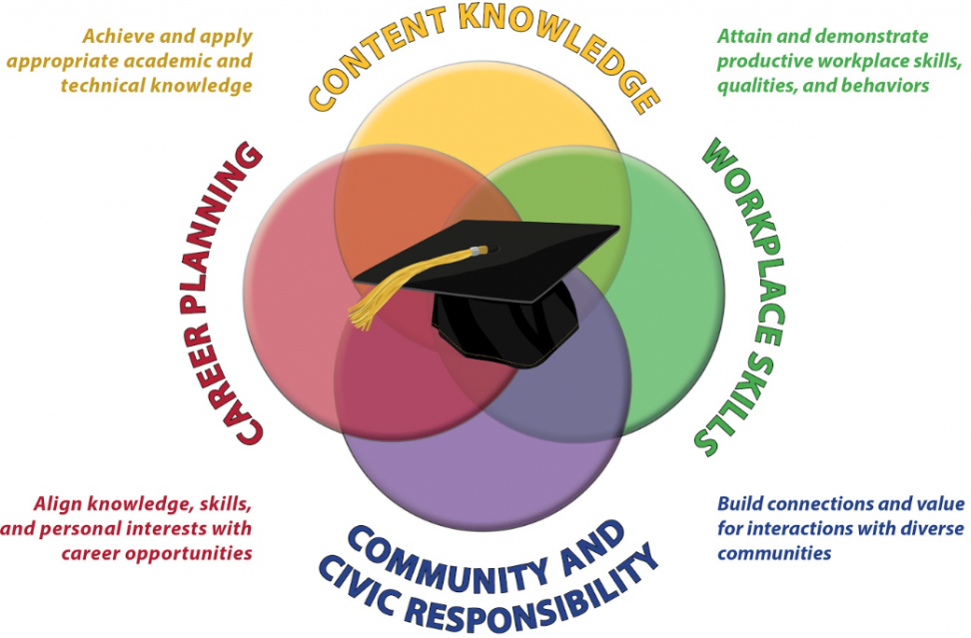
Profiles
Capacity Building
Leaders & Others
Shared Responsibility
Leadership & Systems
Vision, Values & Culture
Leaders & Vision
Profile of a
Virginia
Graduate
Profile of a
Virginia
Leader
Student Experiences
Instructional Design
Learning Community
Skills
Preparation & Support
Knowledge
Profile of a
Virginia
Classroom
Profile of a
Virginia Educator

Slide 5
MODULE I
August 15, 2020
Profile of a Virginia Leader
MODULE II
October 20, 2020
Profile of a Virginia Graduate
MODUEL III
January 3, 2021
Profile of a Virginia Classroom
MODULE IV
April 25, 2021
Profile of a Virginia Educator
Virginia Superintendents’ Leadership Academy
Delivery Framework
Coaching & Virtual Conferences
Innovation ▪ change agents ▪ Deeper learning

Slide 6
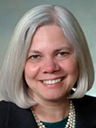
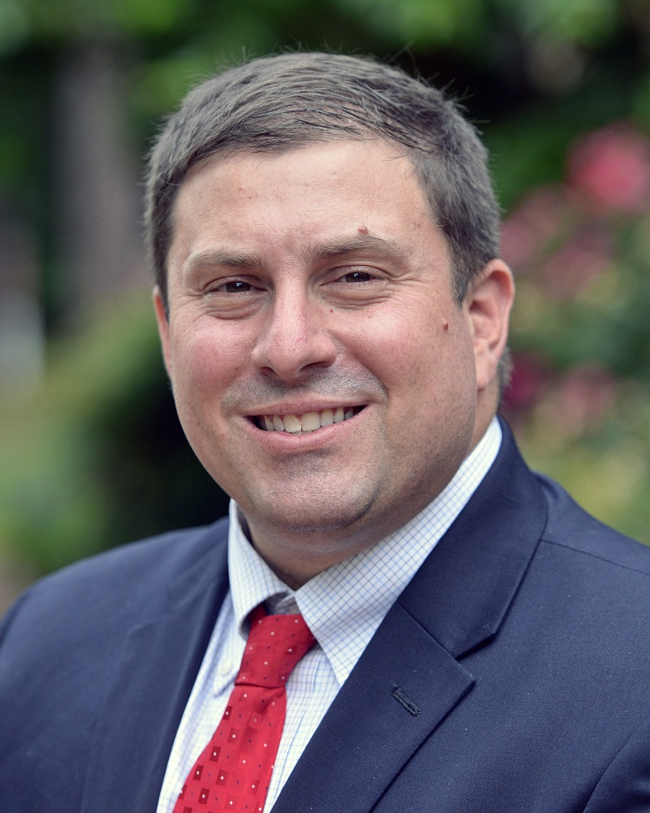
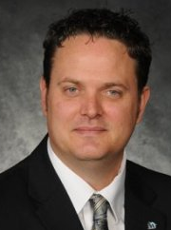
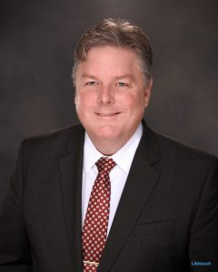
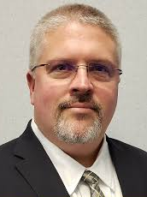
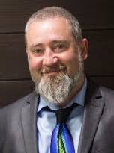
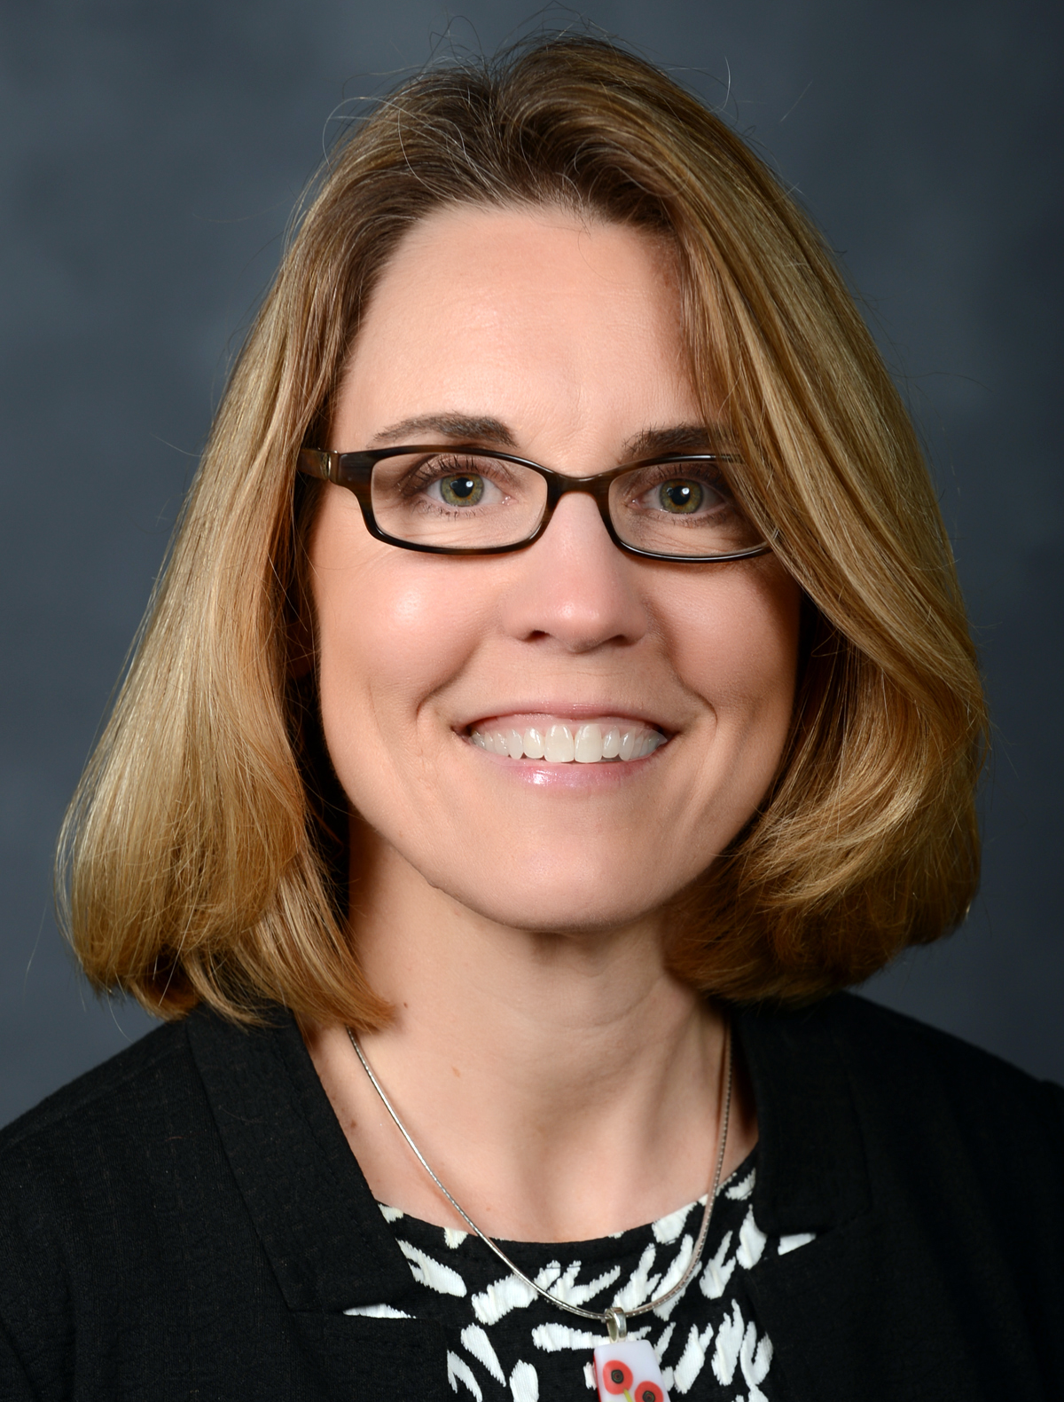
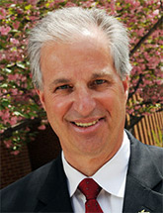
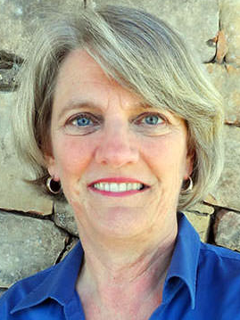
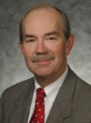
Invited Presenters
Dr. Makola Abdullah President
Virginia State University
Dr. Cyndee Blount
Dr. Deborah
Jewell-Sherman
Professor of Practice in Educational Leadership
Harvard University
Dr. Pam Moran
Executive Director of Statewide Education Professional Development Consortium
Principal
Acquinton Elementary
King William County
Public Schools
Dr. Billy K. Cannaday
State Superintendent
(Retired)
President VA Board of
Education (Retired)
Dr. Dan Domenech Executive Director AASA
Dr. James F. Lane
State Superintendent
Dr. Aaron Spence
Superintendent
Virginia Beach Public Schools
Dr. Jarred A. Cotton Superintendent Chesapeake Public Schools
Dr. David Eshelman Director of Workforce Development
VDOE
Ernest Longworth
Coordinator for Tech Services
Chesterfield County Public Schools
Dr. Adam Seldow
Director Education Product Partnerships
Facebook
Dr. Amy C. Colley
Executive Director
SURN
Dr. Mark Ginsberg Dean, College of Education & Human Development
George Mason University
Dr. Laurie McCullough
Director, Virginia ASCD
Dr. Steve Staples
State Superintendent (Retired)
Executive Director, VASS (Retired)
6
6

Slide 7
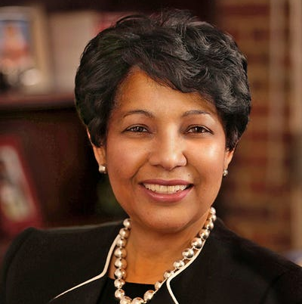
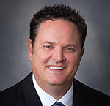
The Virginia Superintendent’s Leadership Academy
Advisory Committee
Dr. Rosa Atkins, Superintendent, Charlottesville Schools
Dr. Cyndee Blount, Principal, Acquinton E.S., King William County Schools
Dr. Amy Colley, Director, W&M School of Education SURN
Dr. Jarred Cotton, Superintendent Chesapeake Schools
Barry DuVal, President & CEO, Virginia Chamber of Commerce
Dr. David Eshelman, Director of Workforce Development, Richmond
Donald (Rusty) Fairheart, Virginia Department of Education
Dr. Mark Ginsberg, Dean School of Education, George Mason University
Ernest Longworth, Coordinator for Tech Services, Chesterfield County Schools
Dr. Steward Roberson, CEO, Mosley Architects
Dr. Adam Seldow, Head of Education Partnerships, Facebook
Dr. Morton Sherman, Associate Executive Director AASA
Dr. Aaron Spence (Co-chair), Superintendent, Virginia Beach Schools
Haydee Robinson, Superintendent, Dickenson County
Application Process
Applications process will be posted on the VASS Website by December 15, 2020
Application deadline: April 15, 2020
Participants in the first cohort will receive a scholarship sponsored by VASS business partners—Tuition TBD

