Slide 1
Intensive Support Needs Funding
VASS/VASBO Conference, January 2020

Slide 2
Agenda
Background/Historical Lens
Overview of Aggregate Data
Data Driven Decisions
Transition Process/Status

Slide 3
Funding Students with Intensive Support Needs

Slide 4
Intensive Support Needs Funding
The Virginia Department of Education (VDOE) continues to transition from the existing funding model to a new funding model to provide equitable distribution of the Special Education Regional Tuition Reimbursement Program funds to all 132 school divisions
Beginning July 1, 2019, The VDOE began facilitating meetings with school divisions participating in the legacy regional program funding model to share the process for transitioning from a rate package to an application, and the change from the term ‘regional program students’ to ‘students with intensive support needs’
By the end of state fiscal year 2020, all participating school divisions will receive funds from the Special Education Regional Tuition Reimbursement Program with the addition of 23 divisions
Process includes verification of eligibility requirements, financial data, and student data

Slide 5
VDOE Authority
Special Education Instruction Payments
The VDOE shall establish rates for all elements of Special Education Instruction Payments.
Out of the appropriations in this item, the VDOE shall make available, subject to implementation by the Superintendent of Public Instruction, an amount for the purpose of the state’s share of the tuitions rates for approved public Special Education Regional Tuition school programs. Notwithstanding any contrary provision of law, the state’s share of the tuition rates shall be based on the composite index of local ability-to-pay.

Slide 6
Historical Perspective
VDOE engaged in a study that started in 2015
VDOE began work soon thereafter to transition to a funding model for Students with Intensive Support Needs, with a more equitable distribution of funding
58 Divisions Received Funding
Majority of Students Received Services in Regular Classrooms
Some Regional Programs altered from Initial Intent

Slide 7
VDOE Communication
Previous Communications Released via Superintendent’s Memoranda
#114-15 (May, 2015); announced the launch of the study
#343-18 (December, 2018); provided an update of the study and planned actions
#171-19 (July, 2019); provided an update on the transition
Transition Meetings and Discussions have been ongoing, with the comprehensive phase completed in December 2019

Slide 8
LEA Status page 1 of 3
Divisions that received funds for the first time in SFY 2018 and SFY 2019, were determined by the actual data submitted and discussions with the VDOE:
Meetings have been held with school divisions
Impact of current funding and future funding has been shared or will be shared based on availability
Applications were due September 30, 2019
LEA should be prepared to provide supporting documentation of students and services sought for reimbursement for verification purposes

Slide 9
LEA Status page 2 of 3
Divisions that are receiving funds for the first time in SFY 2020:
Meetings have been held with school divisions
Technical Assistance has been ongoing concerning the eligibility criteria and application process
Impact of current funding and future funding has been shared or will be shared based on availability
Applications were due on September 30, 2019
LEA should be prepared to provide supporting documentation of students and services sought for reimbursement for verification purposes

Slide 10
LEA Status page 3 of 3
Divisions participating in the eleven original Regional Programs were contacted concerning changing from a Rate Package to individual divisions submitting an Application for Funds for Students with Intensive Support Needs. The VDOE has provided specific direction concerning the time frame for this change.
Meetings have been Held with Each Regional Program as a Group
Meetings have been conducted with Individual School Divisions
Continued attendance at Regional Meetings
Applications due on September 30, 2020
LEA should be prepared to provide supporting documentation of students and services sought for reimbursement for verification purposes

Slide 11
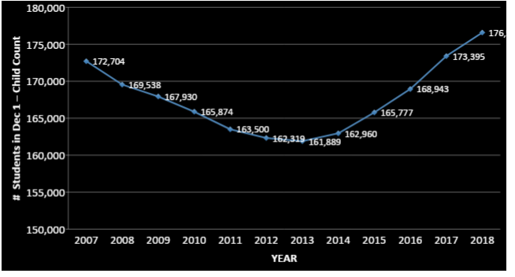
State Child Count Trend Data
Notes:
176,584 total for 2018 Dec 1 CC

Slide 12
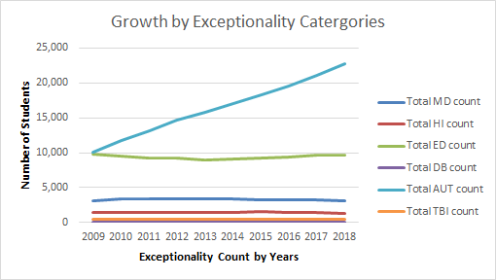
Six Exceptionalities Trend Data

Slide 13
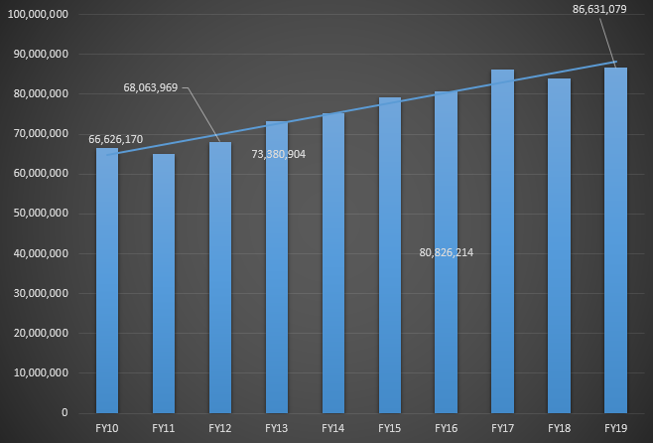
State Share Regional Tuition Expense
Notes:
FY2020 expenditure data are not available....only budget information is provided and LEAs have only submitted for one semester thus far.

Slide 14
Recent Regional Tuition Claims
 | Claim Count | Claim Count | Total Claims in Dollars | Total Claims in Dollars | Total Claims with CI Applied in Dollars | Total Claims with CI Applied in Dollars
 | FY 2019 | FY2018 | FY 2019 | FY2018 | FY 2019 | FY2018
Semester 2 | 4,581 | 4,509 | $72,605,409.87 | $62,891,355.63 | $41,757,969.22 | $39,448,236.43
Semester 3 | 1,638 | 1,997 | $3,417,809.98 | $3,387,101.22 | $2,137,437.70 | $2,138,281.96
Semester 1 | 4,757 | 4,829 | $78,244,166.77 | $69,441,469.35 | $45,045,404.55 | $43,408,447.31
Totals | 10,976 | 11,335 | $154,267,386.62 | $135,719,926.20 | $88,940,811.47 | $84,994,965.70
Notes:
Semester 1 September-January
Semester 2 February-June
Semester 3 July-August

Slide 15
Data Driven Decisions
Preparations for Individual School Division Meetings
Analysis of Child Count Data
Analysis of Students Potentially Eligible for Claiming
Analysis of Costs Directly Associated with Services Called for in the IEP including Related Services
Analysis of Prior Claims or Data Submitted
Analysis of Funding
Analysis of Allowable or Unallowable Costs or Claims

Slide 16
Eligibility Criteria
Required Components
The Student has a current IEP
The Student has been identified on their current IEP as having one of the following as their primary exceptionality:
Autism
Multiple Disabilities
Hearing Impairments
Emotional Disturbance
Traumatic Brain Injury
Deaf/Blindness
The student receives special education services for 85 percent or more of their instructional day as indicated by their current IEP.

Slide 17
Considerations
Students with Intensive Support Needs
Subject to availability, reimbursement may be made available for a portion of the costs associated with placement of children with disabilities in public regional special education programs
Reimbursements are in lieu of other state education funding available for each child (funding based on SOQ model, not associated with this funding)
Supporting the instructional needs of students with intensive support needs

Slide 18
Contact Information
Samantha.Hollins@doe.virginia.gov
www.doe.virginia.gov
Assistant Superintendent, Special Education and Student Services
Twitter: @VDOE_News @smhollins Facebook: @VDOENews
#VAis4Learners

